Slide 1
Financial Preparation for Entrepreneurial Ventures

Slide 2
Learning Objectives
To explain the principal financial statements needed for any entrepreneurial venture: the balance sheet, income statement, and cash-flow statement
To outline the process of preparing an operating budget
To discuss the nature of cash flow and to explain how to draw up such a document
To describe how pro forma statements are prepared
To explain how capital budgeting can be used in the decision-making process

Slide 3
Learning Objectives (cont’d)
To illustrate how to use break-even analysis
To describe ratio analysis and illustrate the use of some of the important measures and their meanings

Slide 4
The Importance of Financial Information for Entrepreneurs
Significant Information
for Financial Management
  The importance of ratio analysis in planning
  Techniques and uses of projected financial statements
  Techniques and approaches for designing
  a cash-flow schedule
  Techniques and approaches for evaluating
  the capital budget

Slide 5
Understanding the Key Financial Statements
Balance Sheet
  Represents the firm’s financial condition
  at a certain date.
    It details the items the firm owns (assets) and
    the amount the firm owes (liabilities).
    It also shows the net worth of the firm and its liquidity.
  Assets = Liabilities + Owners’ Equity
    An asset is something of value the firm owns.
      Current and fixed, tangible and intangible assets
    Liabilities are the claims creditors have against the firm.
      Short- (or current-) and long-term liabilities (or debts)
    Owners’ equity is the firm owners’ residual interest in the firm.

Slide 6
Allowance for Uncollectible Accounts
Number of Days Amount of
Outstanding Receivables
  1–11 $325,000
  11–20 25,000
  21–30 20,000
  31–60 5,000
  61–90 7,500
  91+ 17,500

Slide 7
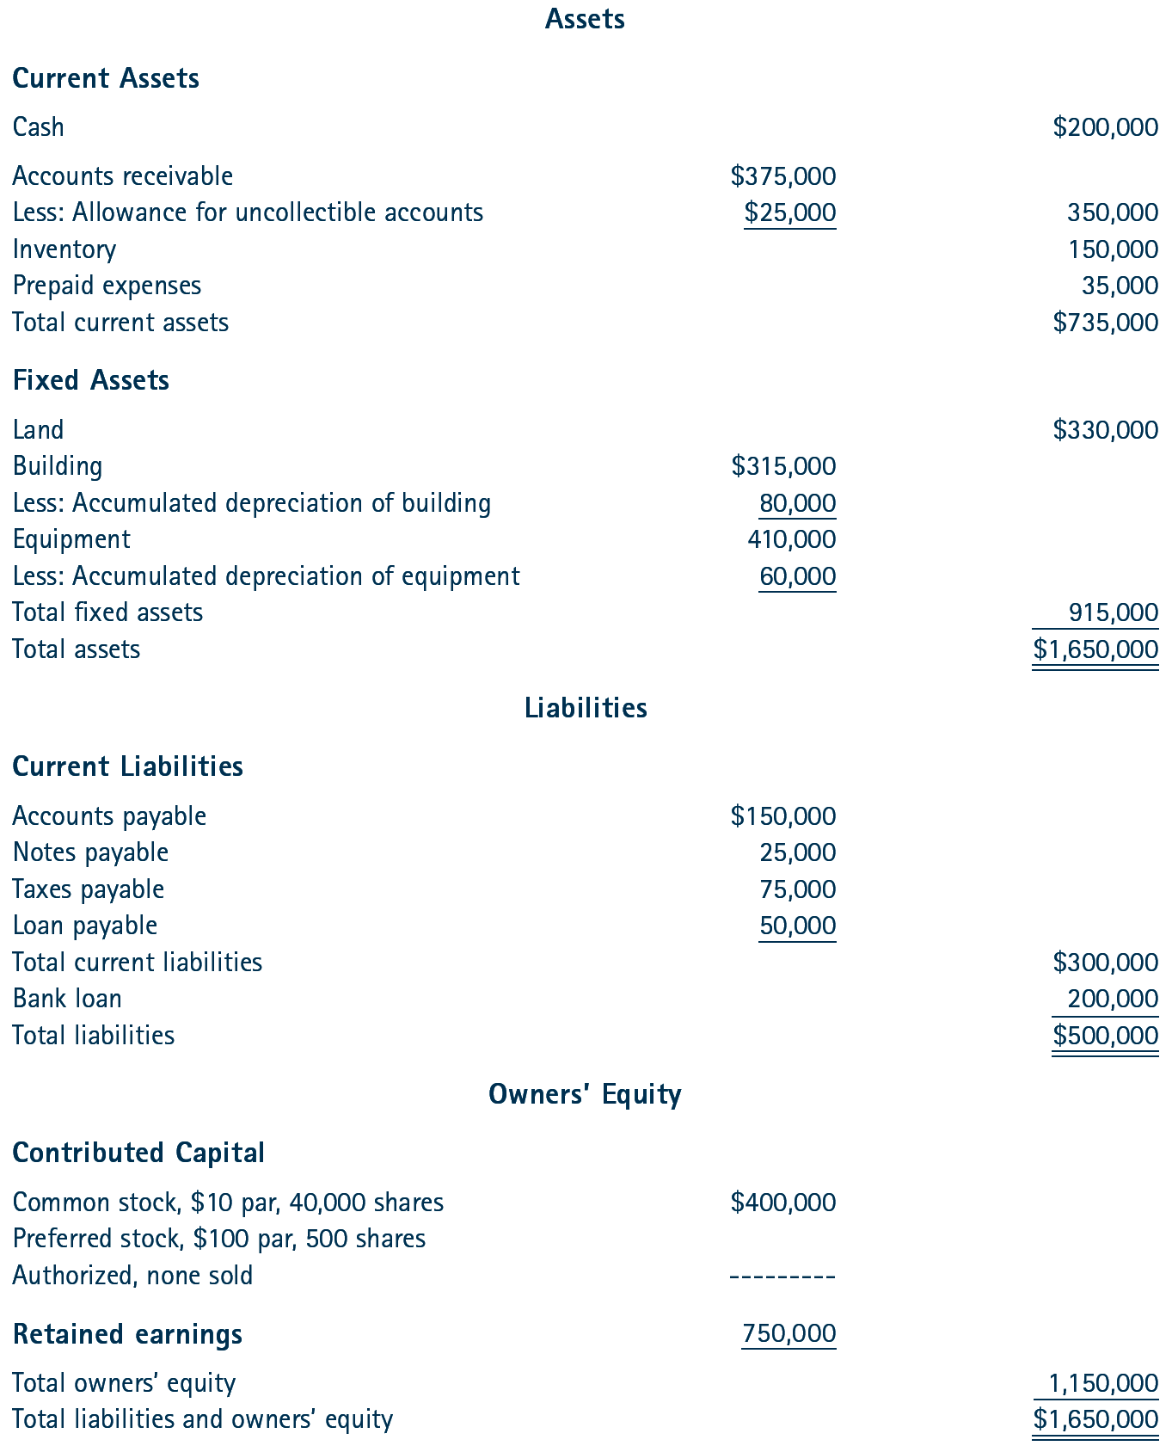
^{Table} 11.2 Kendon Corporation Balance Sheet for the Year Ended December 31, 2018

Slide 8
Understanding Financial Statements (cont’d)
Income Statement
  Commonly referred to as the P&L (profit and loss) statement from activities of the firm.
  Provides a statement that shows the change that has occurred in a firm’s position as a result of its operations over a specific period.
Income Statement Categories
  Revenues: gross sales for the period
  Expenses: Costs of producing goods or services
  Net Income: The excess (deficit) of revenues over expenses (profit or loss)

Slide 9
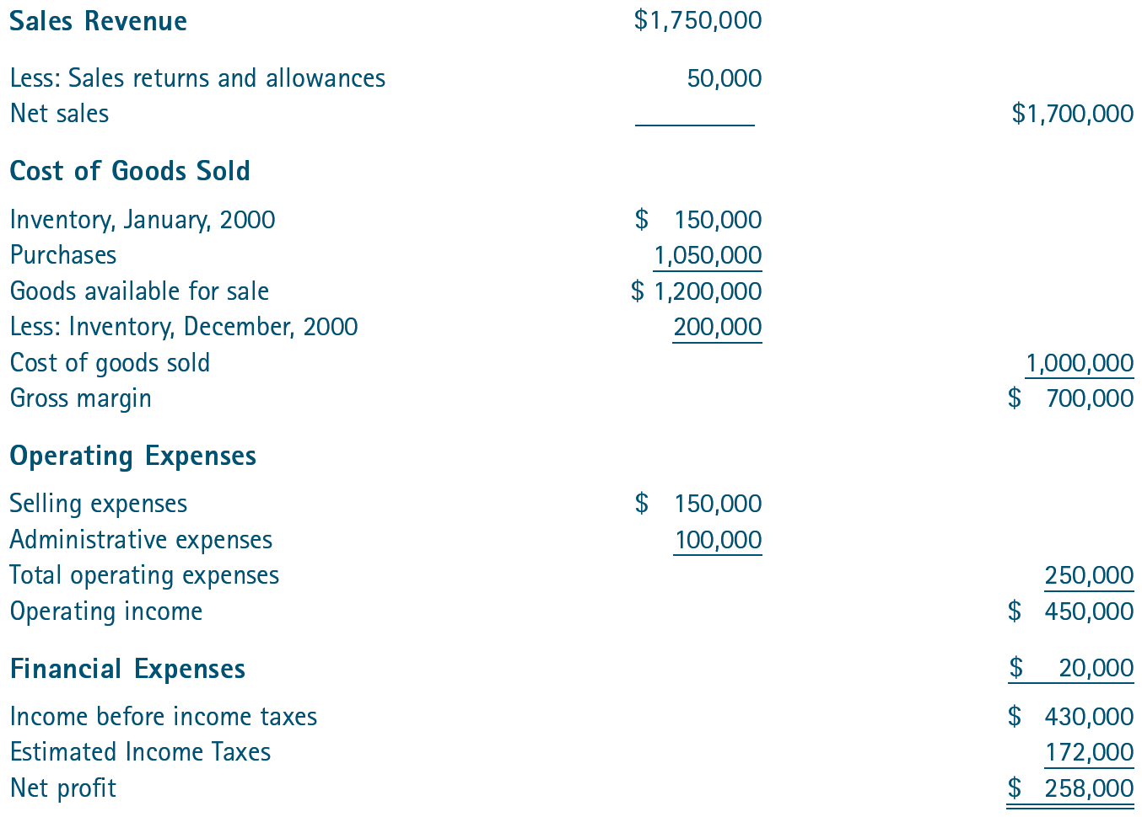
^{Table} 11.3 Kendon Corporation Income Statement for the Year Ended December 31, 2018

Slide 10
Understanding Financial Statements (cont’d)
The Cash-Flow Statement
  An analysis of the cash availability and cash needs
  of the firm that shows the effects of a firm’s operating, investing, and financing activities on its cash balance.
    How much cash did the firm generate from operations?
    How did the firm finance fixed capital expenditures?
    How much new debt did the firm add?
    Was cash from operations sufficient to finance fixed asset purchases?
  The use of a cash budget may be the best approach for an entrepreneur starting up a venture.

Slide 11
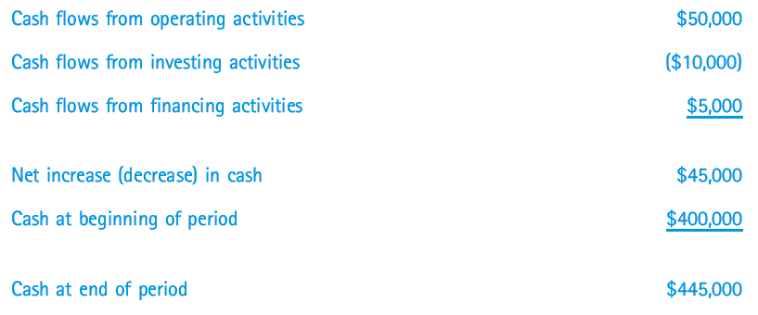
^{Table} 11.4 Format of Statement of Cash Flows

Slide 12
Preparing Financial Budgets
Budget
  One of the most powerful tools the entrepreneur can use in planning financial operations.
Operating Budget
  A statement of estimated income and expenses over a specified period of time.
Cash Budget
  A statement of estimated cash receipts and expenditures over a specified period of time.
Capital Budget
  The plan for expenditures on assets with returns expected to last beyond one year.

Slide 13
The Operating Budget
Sales Forecasting
  Creating an operating budget through
  preparation of the sales forecast.
Forecasting
  Linear regression: a statistical forecasting technique.
  Y = a + bx
    Y is a dependent variable—its value is dependent
    on the values of a, b, and x.
    x is an independent variable that is not dependent
    on any of the other variables
    a is a constant.
    b is the slope of the line of correlation
    (the change in Y divided by the change in x).

Slide 14
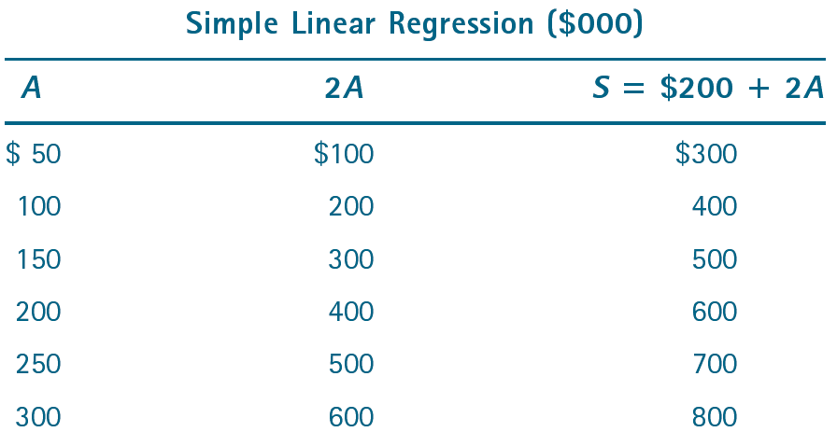
^{Figure} 11.1 Regression Analysis

Slide 15
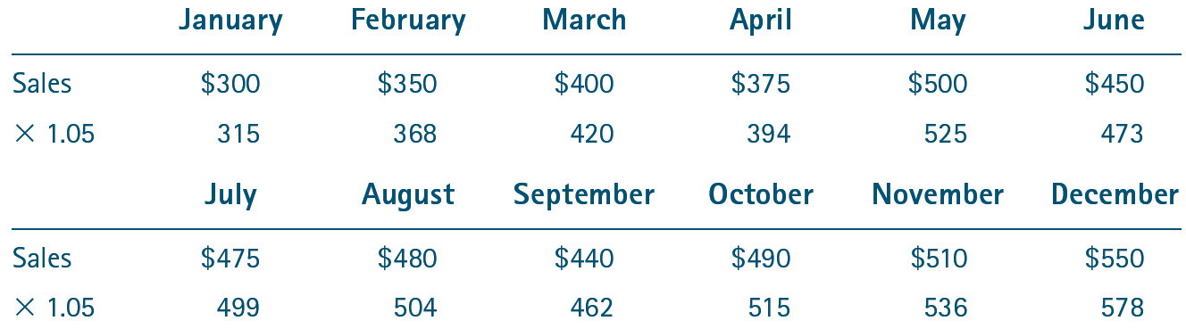
^{Table} 11.5 North Central Scientific: Sales Forecast for 2018

Slide 16
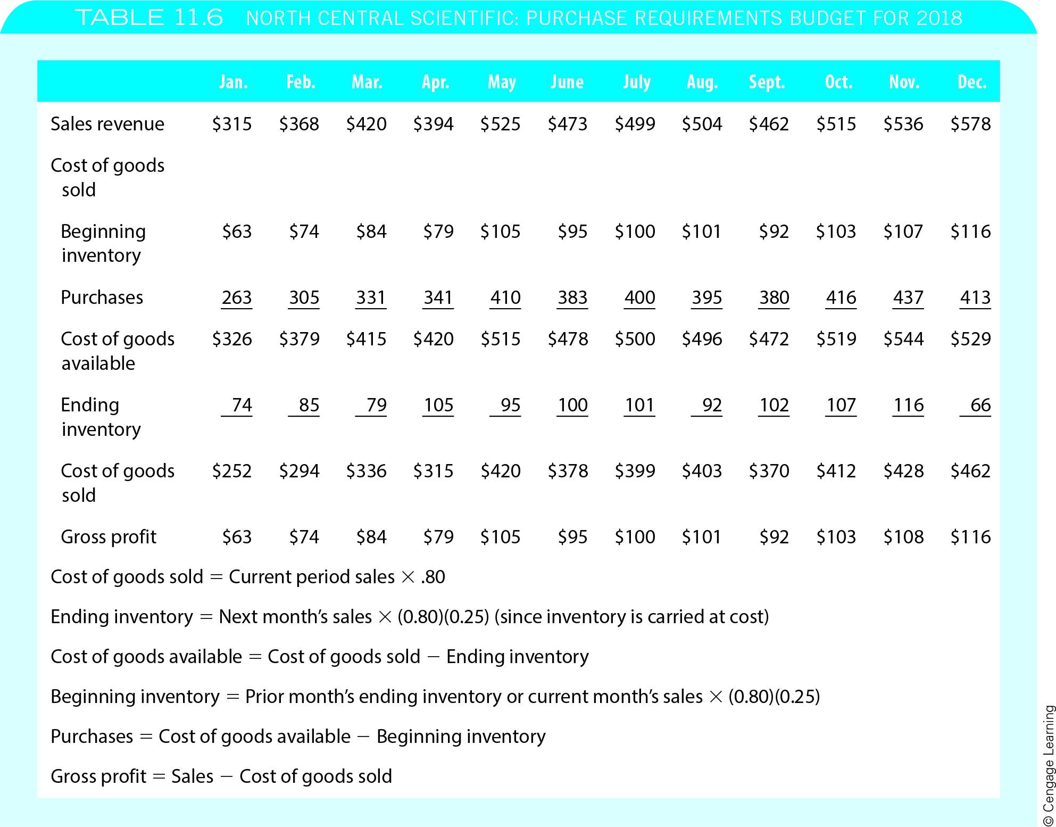
^{Table} 11.6 North Central Scientific: Purchase Requirements Budget for 2018

Slide 17
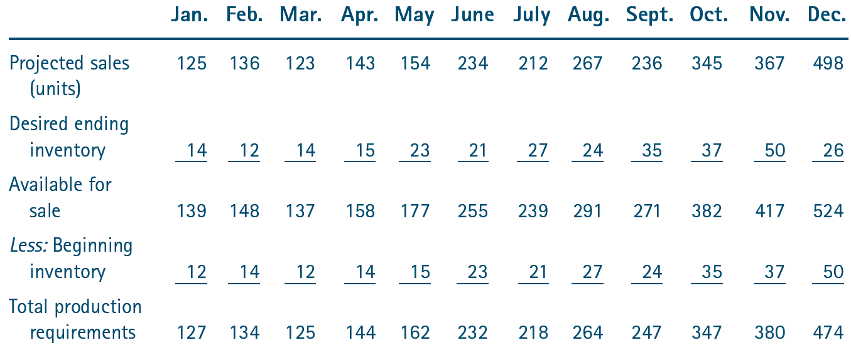
^{Table} 11.7 Dynamic Manufacturing: Production Budget Worksheet for 2018

Slide 18
The Cash-Flow Budget
Cash-Flow Budget
  Provides an overview of the cash inflows and outflows during the period. By pinpointing cash problems in advance, management can make the necessary financing arrangements.
Preparation of the cash-flow budget
  Identification and timing of three cash inflows:
    Cash sales
    Cash payments received on account
    Loan proceeds
  Minimum cash balance

Slide 19
^{Table} 11.8 North Central Scientific: Expense and Operating Budgets
In order to identify the behavior of the different expense accounts, John Wheatman decided to analyze the past five years’ income statements. Following are the results of his analysis:
Rent is a constant expense and is expected to remain the same during the next year.
Payroll expense changes in proportion to sales, because the more sales the store has, the more people it must hire to meet increased consumer demands.
Utilities are expected to remain relatively constant during the budget period.
Taxes are based primarily on sales and payroll and are therefore considered a variable expense.
Supplies will vary in proportion to sales. This is because most of the supplies will be used to support sales.
Repairs are relatively stable and are a fixed expense. John has maintenance contracts on the equipment in the store, and the cost is not scheduled to rise during the budget period.

Slide 20
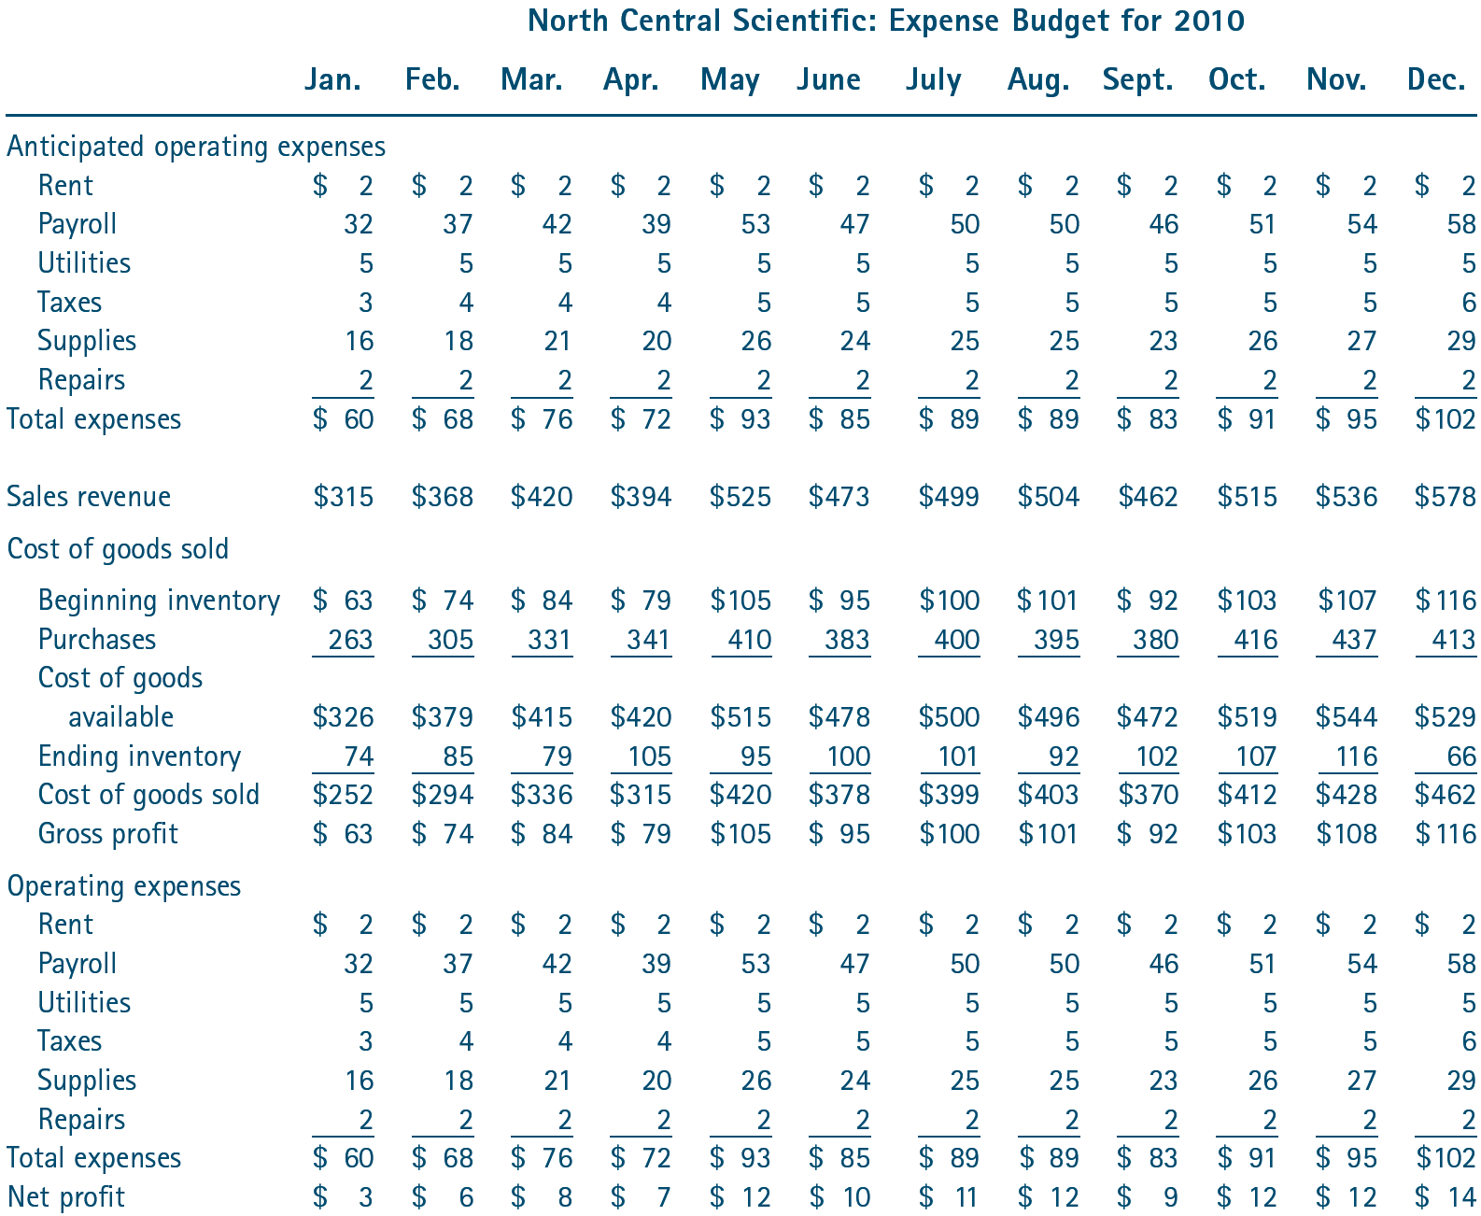
^{Table} 11.8 North Central Scientific: Expense and Operating Budgets (cont’d)
North Central Scientific: Expense Budget for 2018

Slide 21
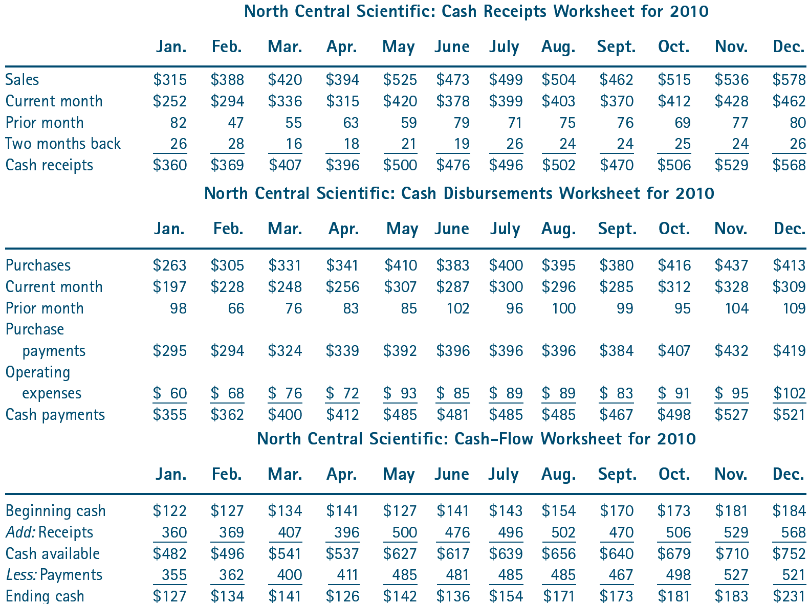
^{Table} 11.9 North Central Scientific: Cash-Flow Budget
North Central Scientific: Cash Receipts Worksheet for 2018
North Central Scientific: Cash Disbursements Worksheet for 2018
North Central Scientific: Cash-Flow Worksheet for 2018

Slide 22
Pro Forma Statements
Pro Forma Statements
  Are projections of a firm’s financial position over a future period (pro forma income statement) or on a future date (pro forma balance sheet).
  Using beginning balance sheet balances, they depict projected changes on the operating and cash-flow budgets which are added to create projected balance sheet totals.

Slide 23
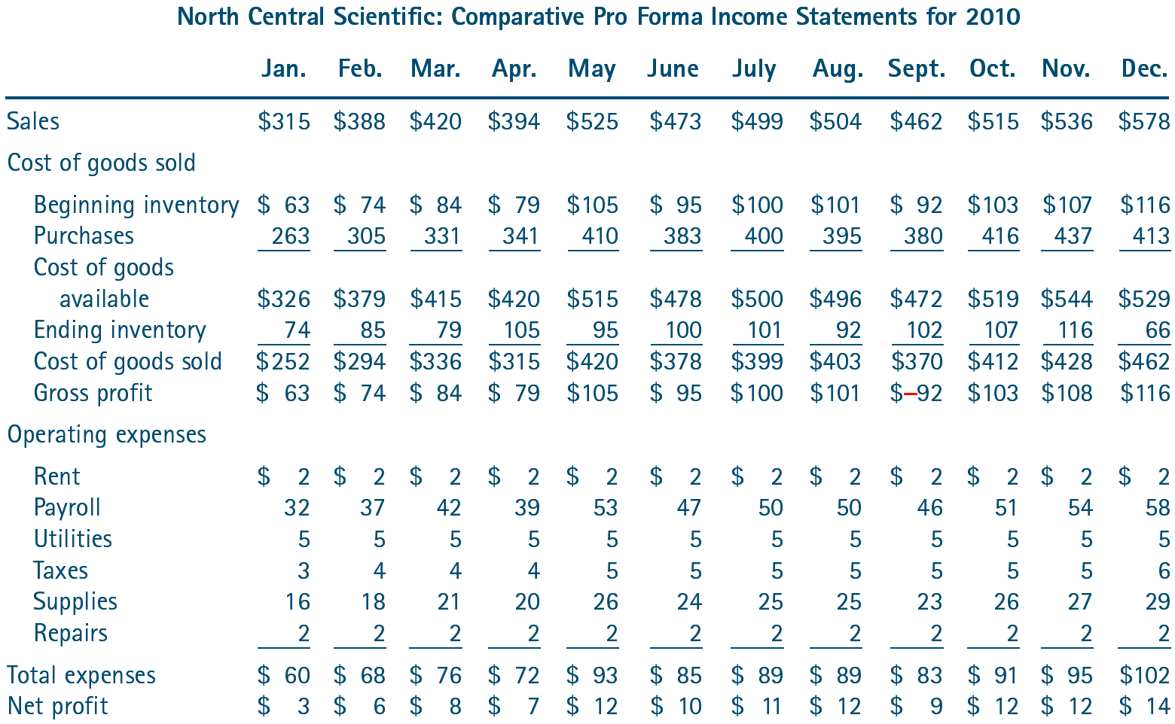
^{Table} 11.10 North Central Scientific: Pro Forma Statements
North Central Scientific: Comparative Pro Forma Income Statements

Slide 24
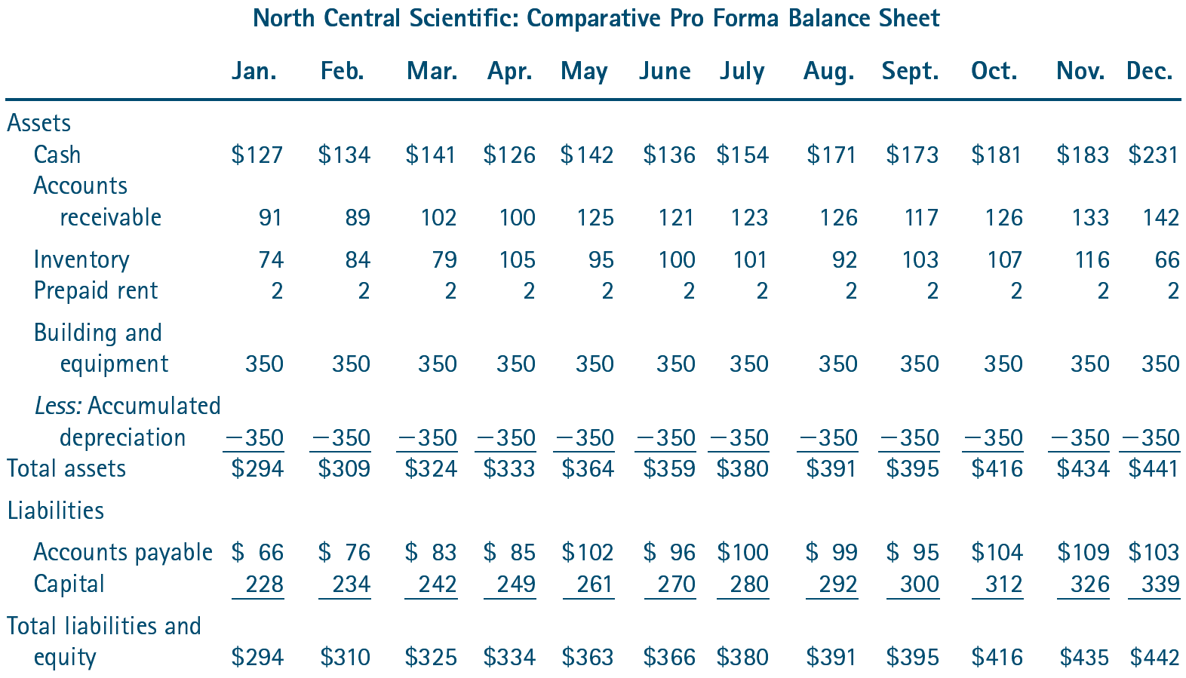
^{Table} 11.10 North Central Scientific: Pro Forma Statements (cont’d)
North Central Scientific: Comparative Pro Forma Balance Sheet

Slide 25
Capital Budgeting
The Capital Budgeting Process
  Identification of cash inflows or returns and their timing
    The inflows are equal to net operating income before deduction of payments to financing sources but after deduction of applicable taxes and with depreciation
    added back, as represented by the following formula:
    Expected Returns = X(1 – 2T) + Depreciation
      X is equal to the net operating income
      T is defined as the appropriate tax rate
Capital Budgeting Objectives
  Which mutually exclusive projects to select?
  How many projects, in total, to select?

Slide 26
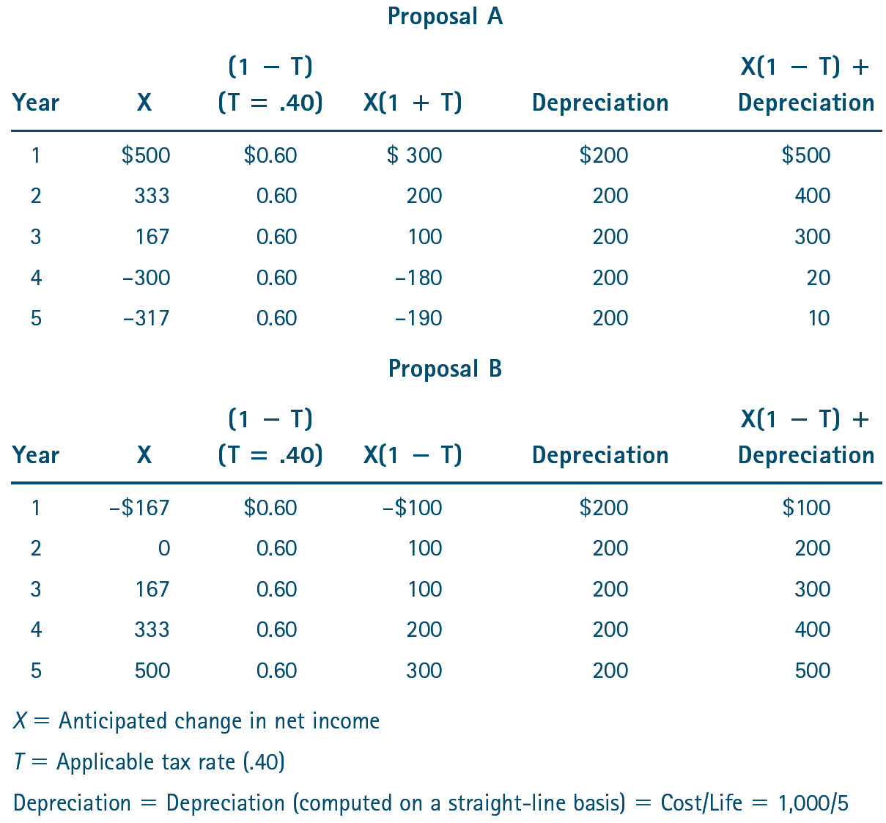
^{Table} 11.11 North Central Scientific: Expected Return Worksheet

Slide 27
Capital Budgeting (cont’d)
Payback Method
  Considers the length of time required to “pay back” (recapture) the original investment.
    Any project that requires a longer period than the maximum time frame will be rejected, and projects that fall within the time frame will be accepted.
    One of the problems with the payback method is that it ignores cash flows beyond the payback period.
  Why it is used?
    Very simple to use compared to other methods.
    Projects with a faster payback period normally have more favorable short-term effects on earnings.
    If a firm is short on cash, it may prefer to use the payback method because it provides a faster return of funds.

Slide 28
Capital Budgeting (cont’d)
Net Present Value (NPV) Method
  The premise that a dollar today is worth more than a dollar in the future.
    The cost of capital is the rate used to adjust future cash flows to determine their value in present period terms.
    This procedure is referred to as discounting the future cash flows—cash value is determined by the present value of the cash flow.
Internal Rate of Return (IRR method)
  Similar to the net present value method, but future cash flows are discounted at a rate that makes the net present value of the project equal to zero.

Slide 29
Break-Even Analysis
Contribution Margin Approach
  Uses the difference between the selling price and the variable cost per unit—the amount per unit that is contributed to covering all other costs.
  Fixed cost assumption:
    0 = (SP–VC )S – FC or FC = (SP–VC)S
  where:
      SP = Unit selling price VC = Variable cost per unit
      S = Sales in units FC = Fixed cost

Slide 30
Break-Even Analysis (cont’d)
Graphic Approach
  Graphing total revenue and total costs.
    The intersection of these two lines (where total revenues are equal to the total costs) is the firm’s break-even point.
  Two additional costs—variable costs and fixed
  costs—also may be plotted.
Handling Questionable Costs
  Certain costs can behave as either fixed or variable costs at different levels of output:
  0 = (SP – VC)S – FC – QC or
  0 = [SP – VC – (QC/U)]S – FC

Slide 31
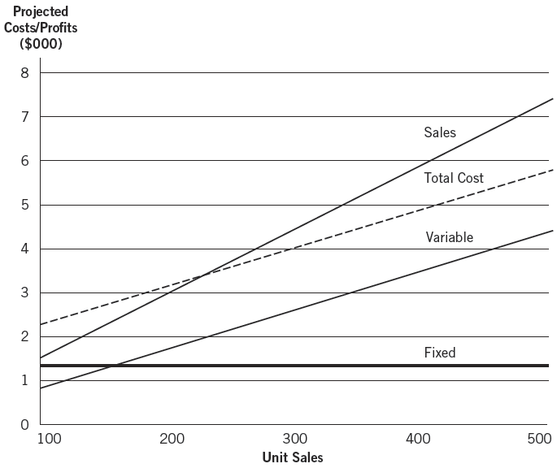
^{Figure} 11.2 Dynamic Manufacturing: Fixed-Cost Assumption

Slide 32
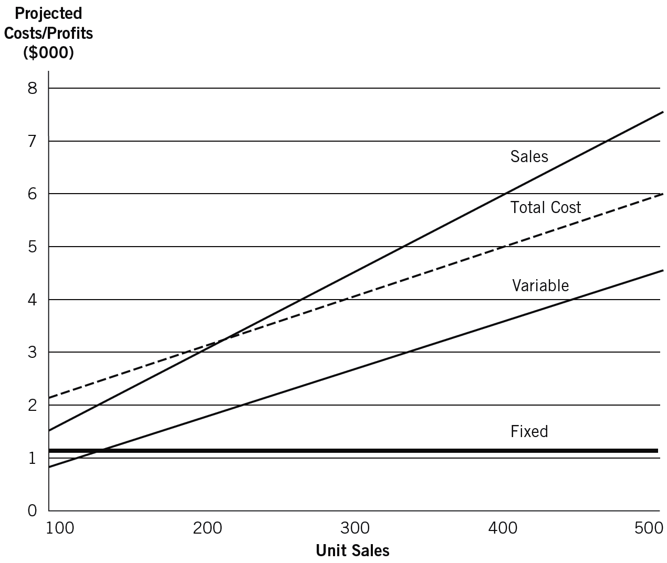
^{Figure} 11.3 Dynamic Manufacturing: Variable-Cost Assumption

Slide 33
Ratio Analysis
Ratios are useful for:
  Anticipating conditions and as
  a starting point for planning actions.
  Showing relationships among
  financial statement accounts.
Vertical Analysis
  The application of ratio analysis to identify financial strengths and weaknesses.
Horizontal Analysis
  Looks at financial statements and ratios over time for positive and negative trends.

Slide 34
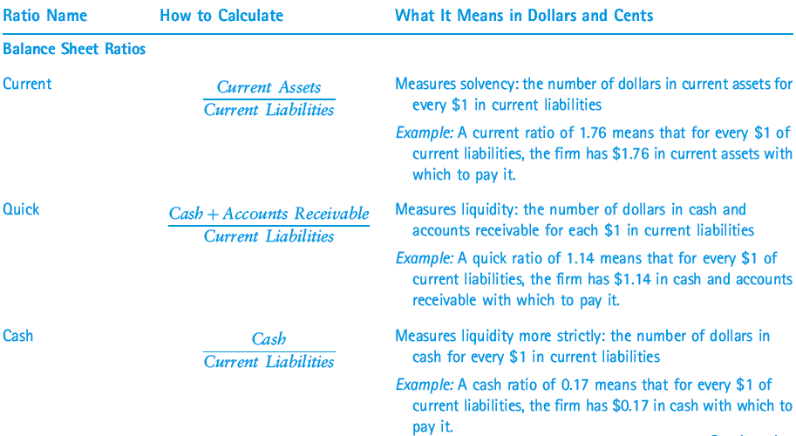
^{Table} 11.12 Financial Ratios

Slide 35
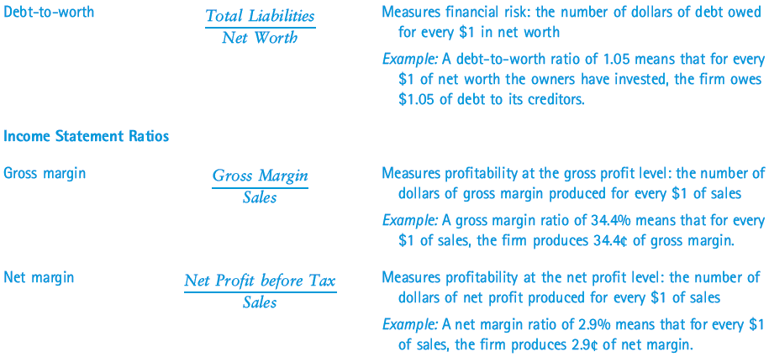
^{Table} 11.12 Financial Ratios (cont’d)

Slide 36
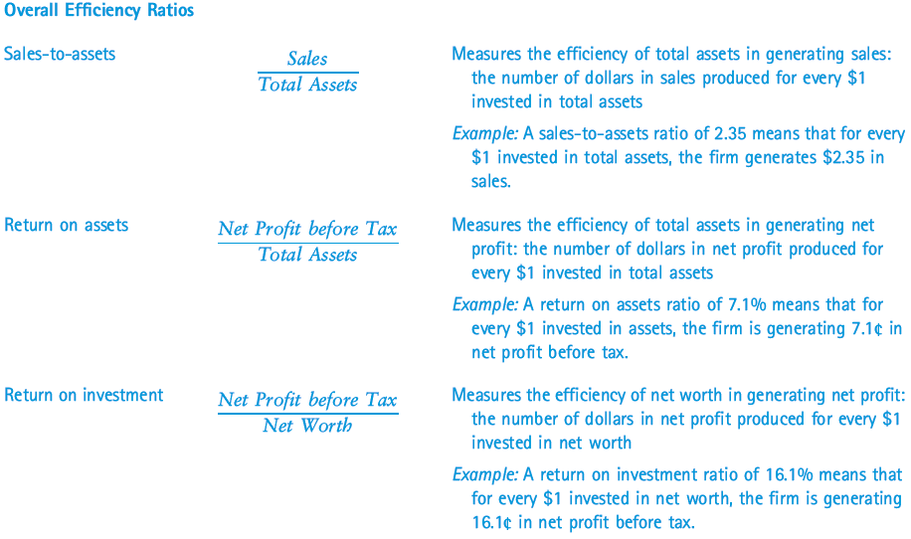
^{Table} 11.12 Financial Ratios (cont’d)

Slide 37
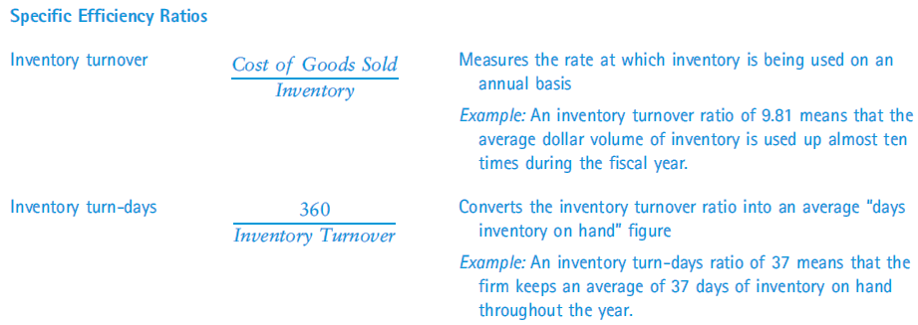
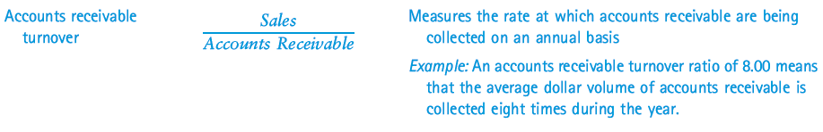
^{Table} 11.12 Financial Ratios (cont’d)

Slide 38
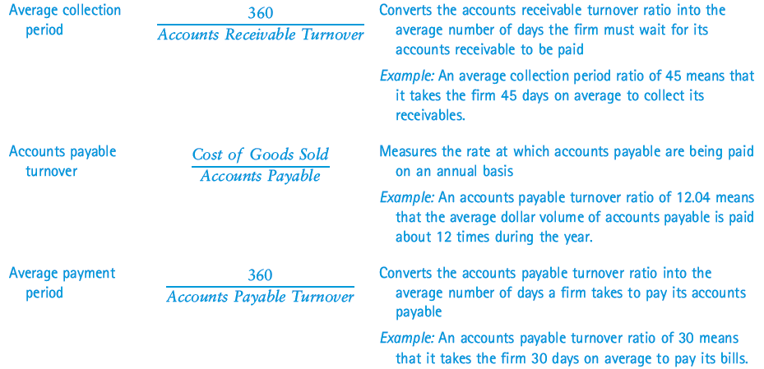
^{Table} 11.12 Financial Ratios (cont’d)

Slide 39
Key Terms and Concepts
accounts payable
accounts receivable
administrative expenses
balance sheet
break-even analysis
budget
capital budgeting
cash
cash-flow budget
cash-flow statement
contribution margin approach
expenses
financial expense
fixed assets
fixed cost
horizontal analysis
income statement
internal rate of return (IRR) method
inventory
liabilities
loan payable
long-term liabilities

Slide 40
Key Terms and Concepts (cont’d)
mixed cost
net income
net present value (NPV) method
notes payable
operating budget
operating expenses
owners’ equity
payback method
prepaid expenses
pro forma statement
ratios
retained earnings
revenues
sales forecast
short-term liabilities (current liabilities)
simple linear regression
taxes payable
variable cost
vertical analysis

